Slide 1


Vision and Perception project
SinGAN: Learning a Generative Model from a Single Natural Image
Lorenzo Nicoletti - 1797464
Leandro Maglianella - 1792507

Slide 2
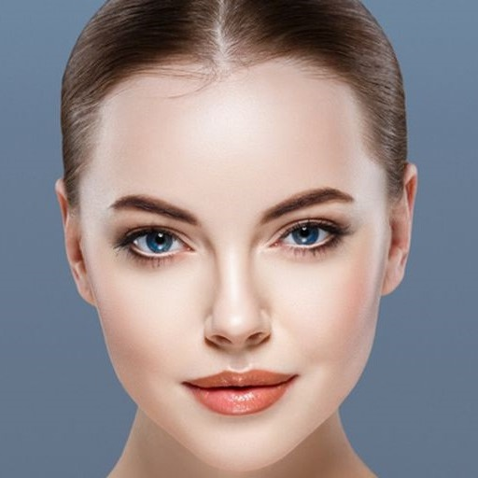
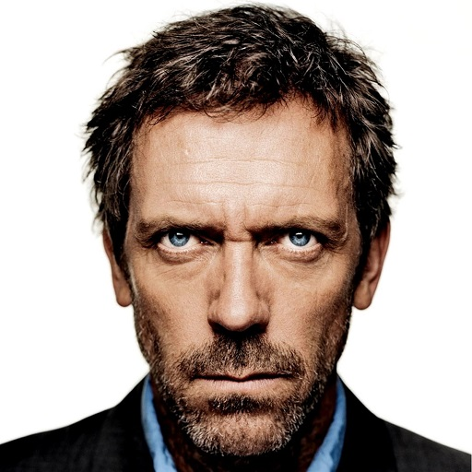

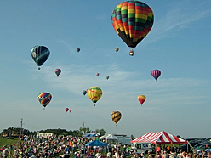
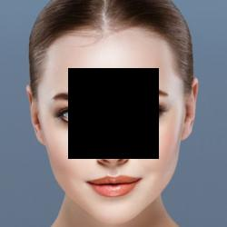

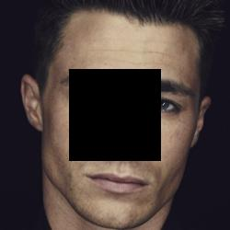
Introduction: what we have done in this project
Our work:
SinGAN with the extreme case of faces:
1. Face Generation
«SinGAN: Learning a Generative Model from a Single Natural Image»
2. Face «Inpainting»
«Random Samples»: random generation of picture from a simple image
Vision and Perception project
Pagina <number>

Slide 3
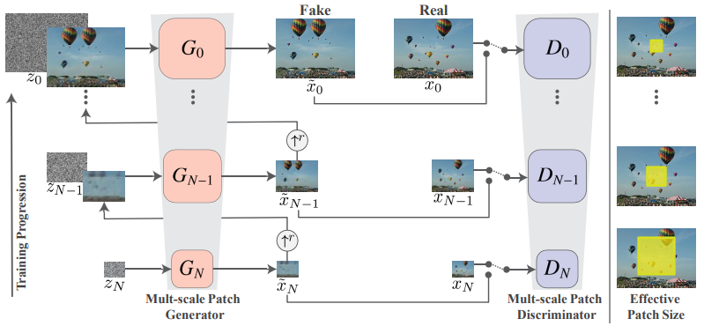
But what is a SinGAN?
Overview of the model and its functioning
A SinGAN is a pyramid of fully convolutional GANs, each responsible for learning the patch distribution at a different scale of the image.
Vision and Perception project
Pagina <number>

Slide 4
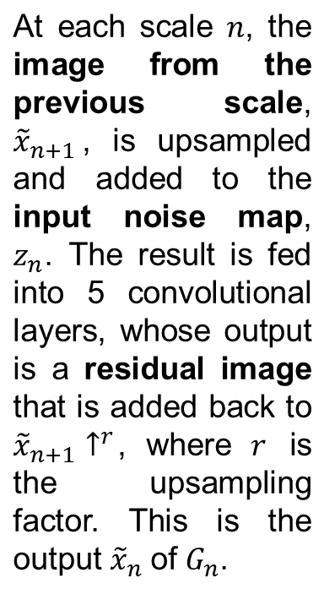
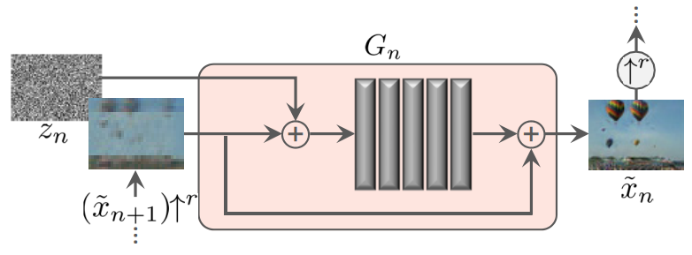
But what is a SinGAN?
Overview of the model and its functioning
Vision and Perception project
Pagina <number>

Slide 5
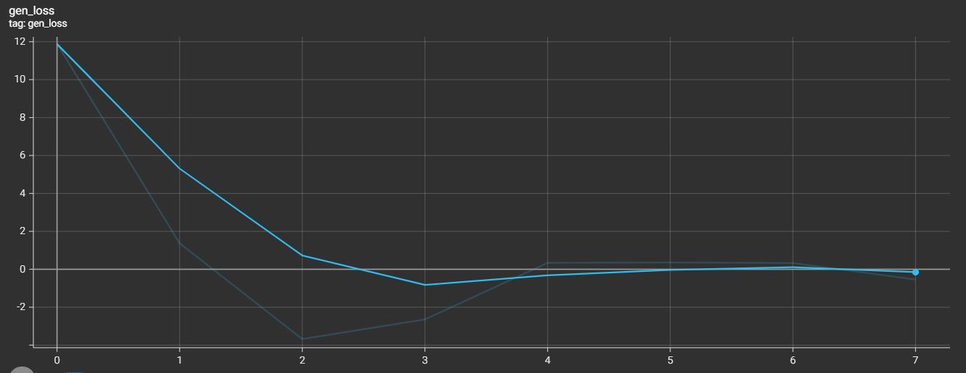
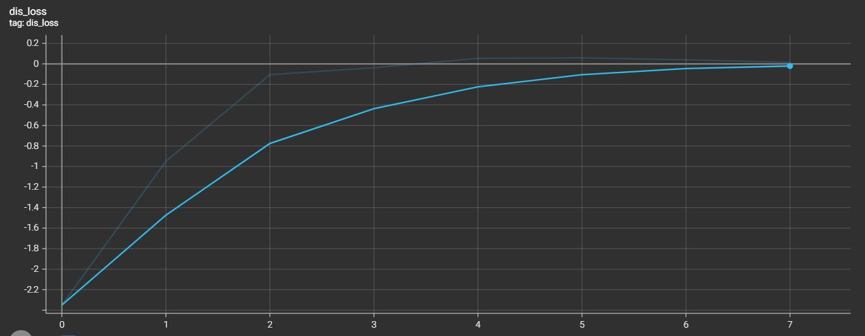
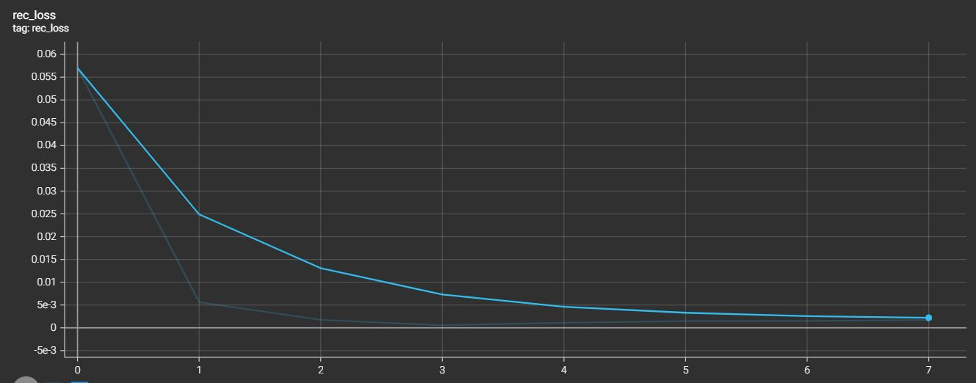
Starting our journey with SinGAN
(re-)implementation of the paper: «Random Samples»
The «Random Samples» task consists in generating images that depict new realistic structures and configuration of objects, while preserving the visual content of the training image.
Training procedure: integrating Adversarial Learning in SinGAN
The pyramid of generators is trained with the image pyramid such that each generator learns to fool the associated discriminator. We monitor two losses:
Adversarial loss
Reconstruction loss
Vision and Perception project
Pagina <number>

Slide 6
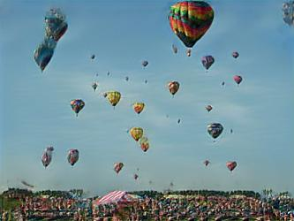
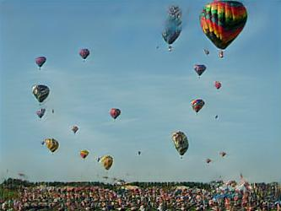
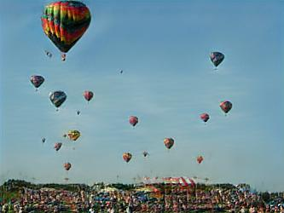
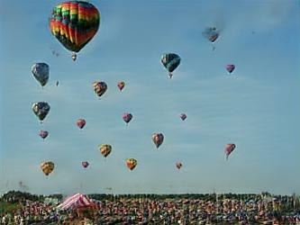
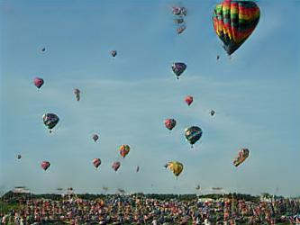
Starting our journey with SinGAN
(re-)implementation of the paper: «Random Samples»
Vision and Perception project
Pagina <number>

Slide 7
Our extension: extreme case of faces
Why is a face an «extreme case»?
An «extreme case» consists in an image whose structure is of high importance.
We are aware that a face has a specific and ordered disposition: we cannot just ‘insert balloons’ and create new samples, but we need to preserve the face’s global structure.
Vision and Perception project
Pagina <number>

Slide 8
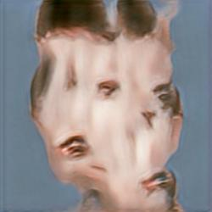
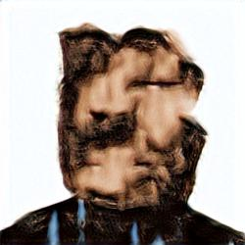
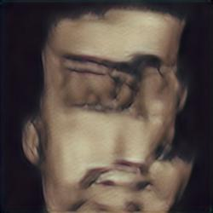
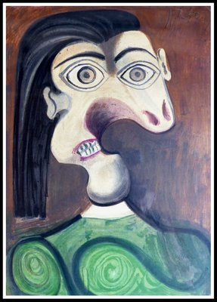
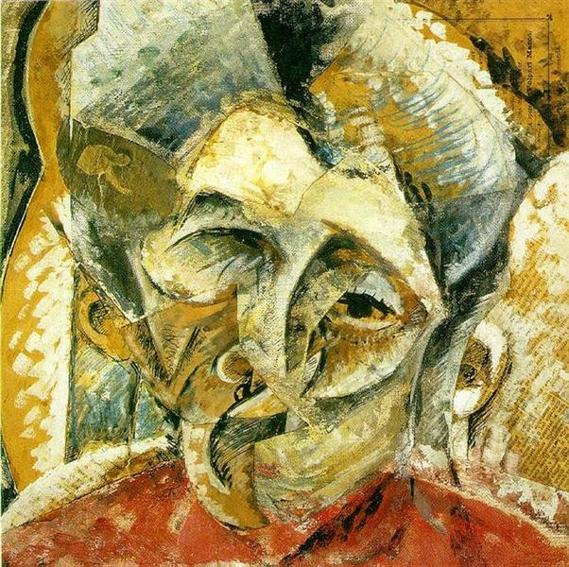
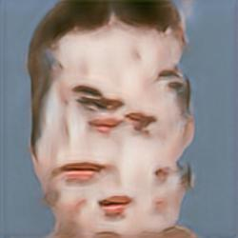
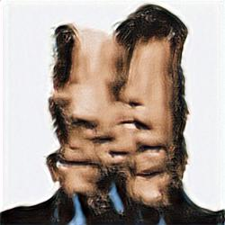
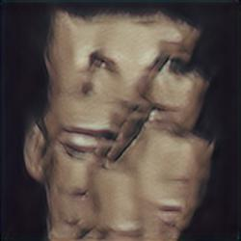
Our extension: extreme case of faces
What if we do NOT take into account this fact?
We produce failure cases.
Unfortunately, we are not replicating portraits by Picasso or Boccioni!
We want to generate accurate faces, so we need to find a solution.
Vision and Perception project
Pagina <number>

Slide 9
Our extension: solving the failure cases
scale
High scale ⇒ Large effective patch size
scale
7
7
6
6
Start generation here in extreme cases
5
5
4
4
3
3
2
2
1
1
0
0
Low scale ⇒ Small effective patch size
scale factor = 0.75
scale factor = 0.6/0.5
min size = 25px
Original SinGAN pyramid
Our SinGAN pyramid
For extreme cases, the paper suggests starting the generation at a lower scale: only finer details are randomized.
Our architecture is designed to better learn the face’s general structure (in the 3 highest scales) and only then to work on finer details.
But in this way large details are completely unchanged!
Using our approach, the entire image is correctly randomized!
Vision and Perception project
Pagina <number>

Slide 10
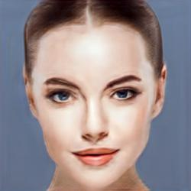
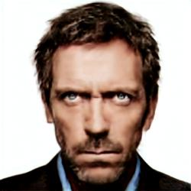
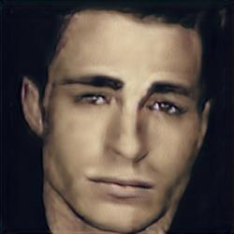
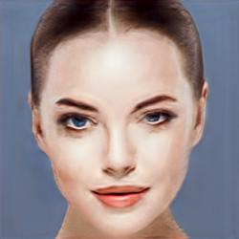
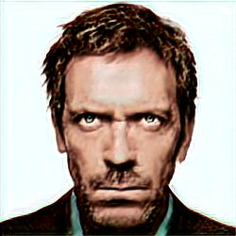
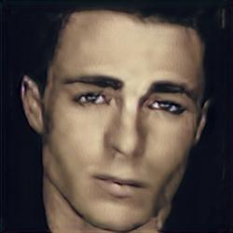
Our extension: failure cases are solved!
Reshaping
We are now able to generate faces that preserve their global structure.
In particular, our model acts reshaping some of the face’s components or slightly changing their lighting.
Reshaping
Lighting
Vision and Perception project
Pagina <number>

Slide 11
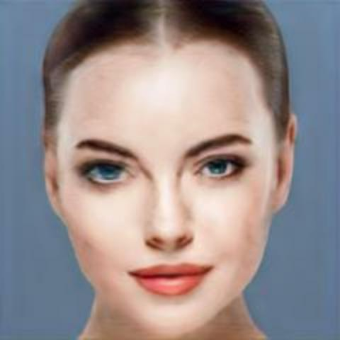
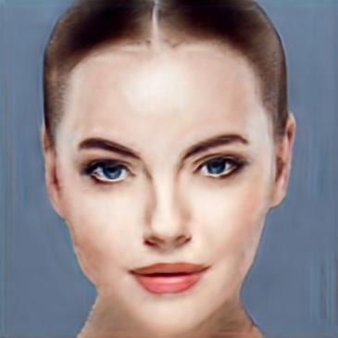
Our extension: trained models
We produced 3 models for each face: they are trained using different max sizes and can generate images accordingly.
250 × 250
365 × 365
480 × 480
Vision and Perception project
Pagina <number>

Slide 12
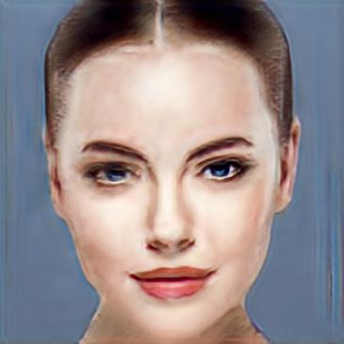
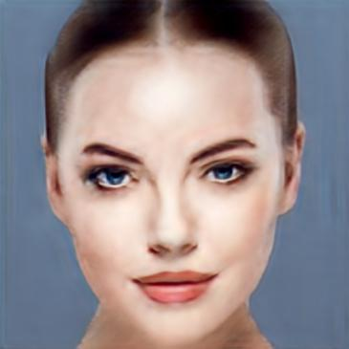
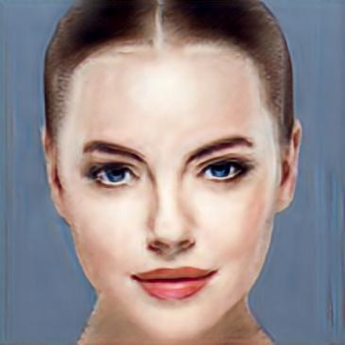
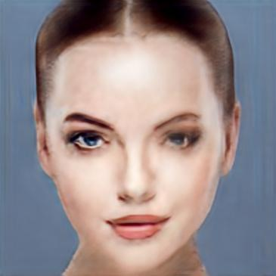
Our extension: face generation results (face1)
Vision and Perception project
Pagina <number>

Slide 13
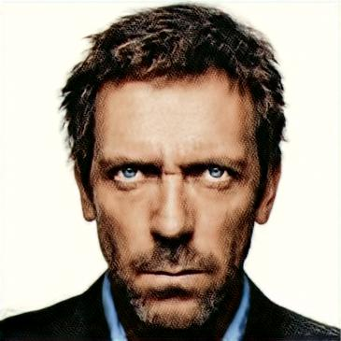
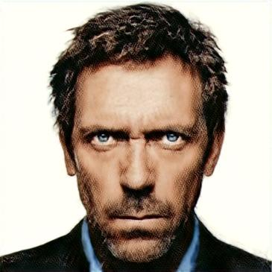
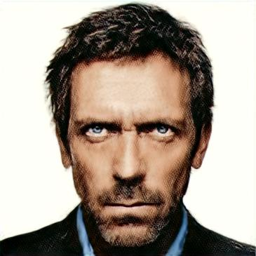
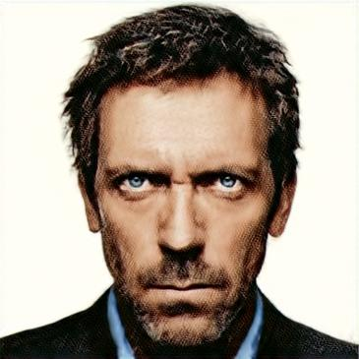
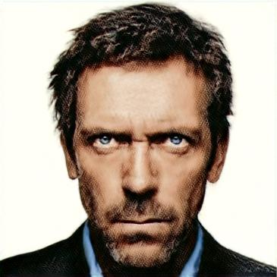
Our extension: face generation results (face2)
Vision and Perception project
Pagina <number>

Slide 14
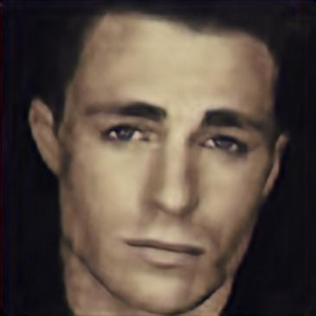
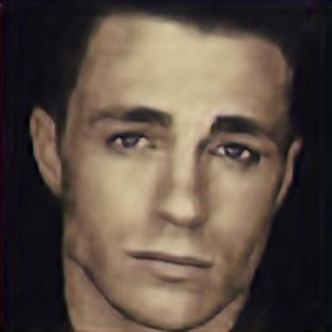
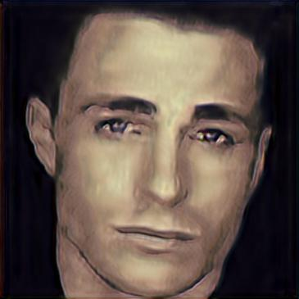
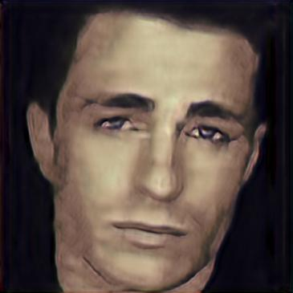
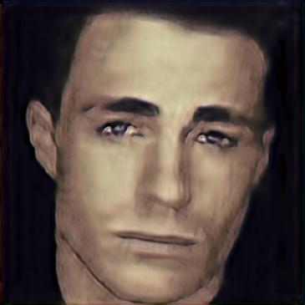
Our extension: face generation results (face3)
Vision and Perception project
Pagina <number>

Slide 15
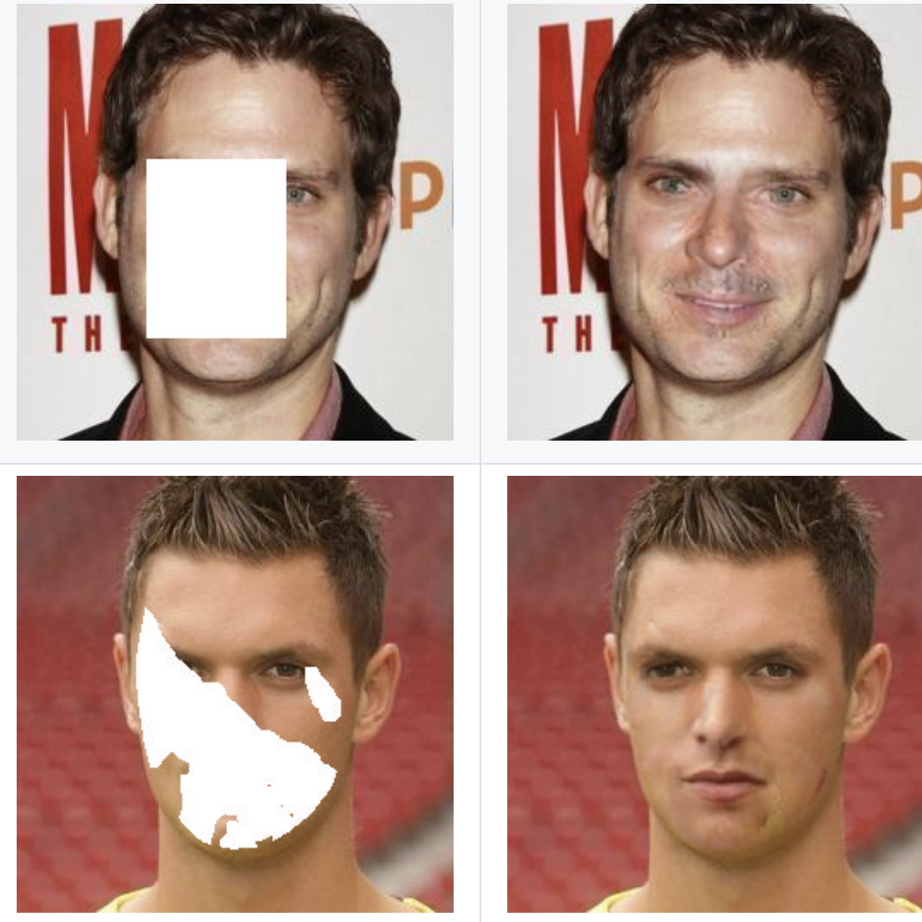

Our second extension: face inpainting
Face inpainting is the task of generating plausible facial structures for missing pixels in a face image.
..but SinGAN is not designed for this task!
SinGAN’s training process does not change depending on the task and it works on only one image at a time.
Vision and Perception project
Pagina <number>

Slide 16
Our second extension: face inpainting
As a starting point, we covered our three face images with a black squared mask.
Our approach was to apply our SinGANs (already trained on the completed images) on the uncompleted images to fill the masked areas with the learnt features of realistic faces.
Vision and Perception project
Pagina <number>

Slide 17
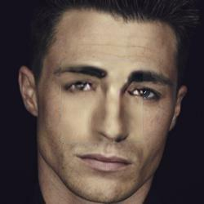
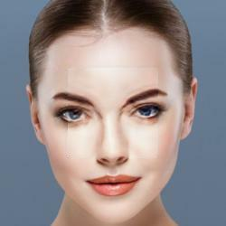
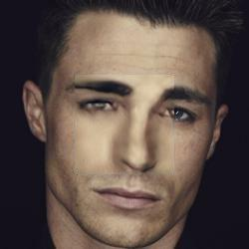






Our second extension: face inpainting results
Vision and Perception project
Pagina <number>

Slide 18


Conclusions
SinGAN can provide a very powerful tool for a wide range of image manipulation tasks.
In particular, our SinGAN focused on solving “extreme cases” where the image’s global structure is of high importance.
Our architecture demonstrated to be valid, generating good and complete results regardless of the task.
Nevertheless, internal learning is inherently limited in terms of semantic diversity compared to externally trained generation methods.
Vision and Perception project
Pagina <number>

